Slide 1
Computer Security
By Robert Gabriel

Slide 2
What is Computer
Security?
The significance of the term computer security has evolved in recent years.
To prevent theft of or harm to the hardware
To prevent theft of or damage to the data

Slide 3
Why is it important
Computer security helps in ensuring information from threats such as theft or misuse.
It enables the privacy of you and safeguards your system from viruses or natural calamities.
It keeps your passwords safe and avoiding visiting unsafe sites.

Slide 4
Why is it important
Because without it, your computer would be vulnerable to viruses and other malicious code.
Security Tool are a rogue anti spyware program that uses fake system scan results to convince users to believe that they must purchase the Security Tool program to remove the found threats.

Slide 5

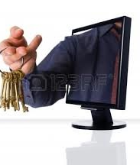
Security Tools
Security Tools, through the use of Trojans and malicious websites, can be installed onto your computer without telling you.

Slide 6

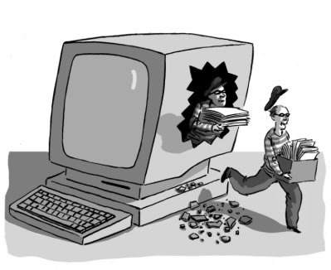
Types of Attacks
The following are different types of attacks:
Network
Wiretapping
Port scanner
Denial-of-service attack
Spoofing
Man in the middle
Ping flood
HostStack overflow

Slide 7
Types of Deference
Use a firewall
Use virus protection
Use spyware protection
Update Windows automatically
Install the latest version of your web browser and keep it up to date

Slide 8

Questions
Thank You for having me

